Slide 1
EMOTION DETECTION IN TEXT.
Rohith Abburi

Slide 2
• The aim of this project is to develop an advanced natural language processing (NLP) system capable of accurately identifying and categorizing emotions in text data, with potential applications across various domains.
• Practical uses include monitoring emotional states in mental health, improving chat bot empathy in customer service, and providing insights into public sentiment through social media analytics.
• This project refines the accuracy and depth of emotion recognition, contributing to a broader understanding of public emotions.

Slide 3
DATA PREPARATION & PROCESSING
3
Data Preparation
The dataset tweet_emotions is loaded into a pandas DataFrame, containing numerous tweets with associated emotions
The dataset is split into training (80%), validation (16%),
and test (4%) sets. This is done to ensure that the model is trained on a large portion of the data, validated on a smaller portion, and finally tested on a separate set to evaluate its performanc
Preprocessing
The content from the training data is tokenized. This process involves converting the text into a list, removing punctuation, and then splitting it into individual words or tokens. The Tokenizer from Keras preprocessing is used for this purpose. It helps in converting the text data into sequences of integers, where each integer represents a specific word in a dictionary

Slide 4
Presentation title
4
Architecture and Training
MODEL ANALYSIS
A custom TensorFlow Keras layer, T_encoder, is defined, which includes multiple layers such as MultiHeadAttention, Dense, Dropout, and LayerNormalization. This architecture is indicative of a Transformer model, which is effective for handling sequence data like text.
Learning rate schedulers and early stopping callbacks are used during training. The learning rate scheduler adjusts the learning rate throughout training, potentially improving model performance by fine-tuning the learning process. Early stopping is used to halt the training if the model's performance on the validation data doesn't improve, preventing overfitting

Slide 5
Presentation title
5
Fitting and Evaluation
MODEL ANALYSIS
The model, named model_transformer, is trained on the tokenized training data (x_train and y_train) for 25 epochs, with validation data provided for performance monitoring. This process involves feeding the input data into the model, which learns to predict the emotion associated with each tweet
After training, the model is evaluated on the test set (x_test and y_test). Performance metrics like the confusion matrix, F1 score, precision, and recall are calculated. These metrics provide insights into the model's ability to correctly classify emotions in tweets, with a focus on both the accuracy and balance of predictions across different emotion classe

Slide 6
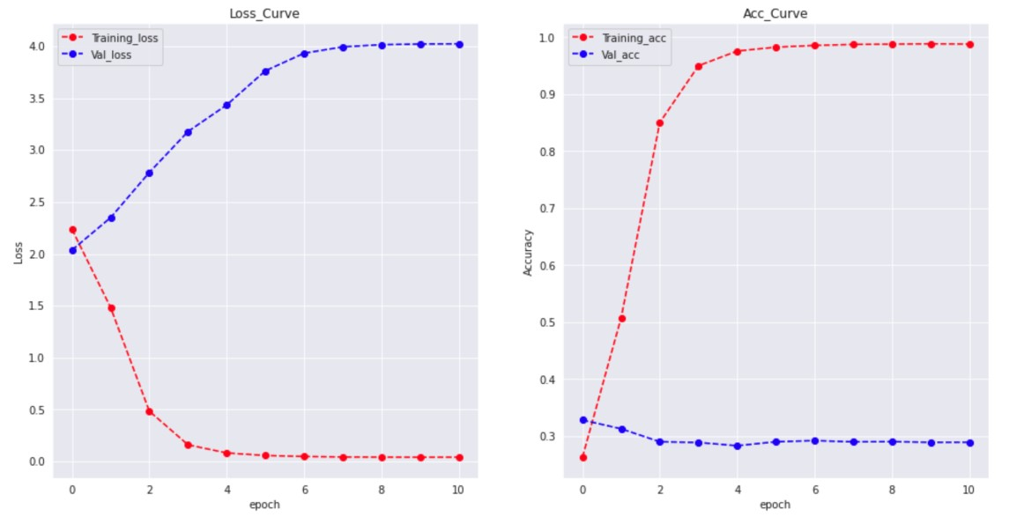
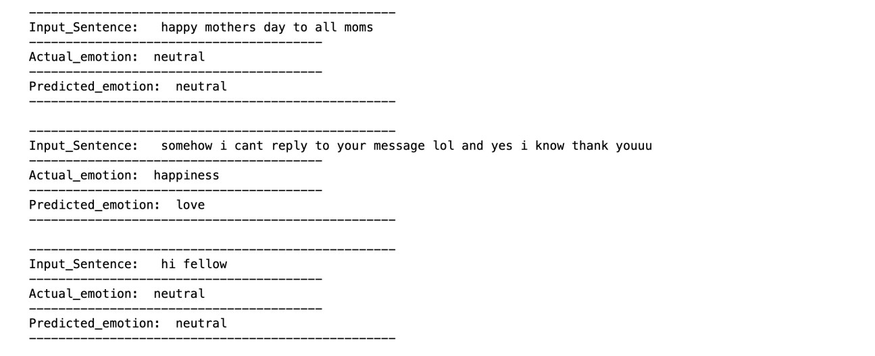
RESULTS
Presentation title
6
The accuracy and loss curves for both the losses from training and validation are plotted as shown above.
And the respective calculated metrics are:
f1_score: 0.3053817271589487
Precsion: 0.3053817271589487
Recall: 0.3053817271589487
And with the inference test the respective results from the model are shown here.

Slide 7
THANK YOU

